Slide 1

Care At Home:
Data Classification Standards & Risk Methodology
By: Mayowa toyinbo
This Photo by Unknown Author is licensed under CC BY-SA

Slide 2
Table of contents
Introduction
Company Background
Purpose of Data Classification Standards
Data Categorization
Data Classification Standards
Types of Data & Their Classifications – Private Data
Types of Data & Their Classifications – Confidential
Types of Data & Their Classifications – Internal Use Only
Types of Data & Their Classifications – Public Domain Data
Data Security Recommendation and Justification
Conclusion
References

Slide 3
Introduction
Data breaches have been a prevalent topic in cybersecurity communities over the years, and one of the main targets of threat actors has been healthcare facilities due to the large amount of patient data being handled by healthcare organizations.
Proper data classification is essential for protecting this information and ensuring compliance with regulations like HIPAA.
This presentation outlines the data classification standards at CareAtHome, detailing the different data categories and the security measures for the categories.

Slide 4

Company Background
Goal
The Goal of Care At Home is to realize better outcomes for patients as they transition home from the hospital, lower healthcare costs, and be a model for addressing what truly determines good health.
Locations
Orange County, California
Inland Empire, California.
(Care at home, 2024)

Slide 5
Purpose of Data classification standards
Prevents Unauthorized Access – Data breaches often stem from improper access control. Classifying data ensures that only authorized personnel handle sensitive information.
Ensures Regulatory Compliance – (HIPAA) mandates the protection of patient information. Classification helps meet legal and industry standards.
Enhances Security Measures – Knowing the sensitivity of data allows for tailored security controls (e.g., encryption for financial data).
Improves Operational Efficiency – Organized data storage prevents mismanagement and accidental exposure.

Slide 6

Data Categorization
The data categories employed in CareAtHome’s system are listed in the slides below.

Slide 7
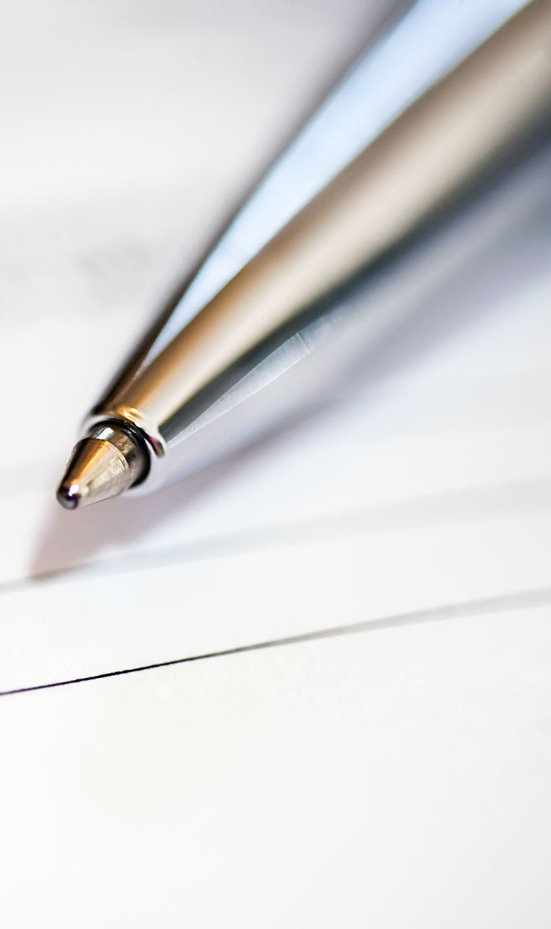
Data Categorization
Payment/Billing
  Insurance
  Credit/Debit
  Address
  Patient Name
  Contact
  Card verification value (CVV)
Regulations/Compliance
  Name
  Description
  Patient Data
  Reporting
  Agency/Govt.
  Location
Employees
  Name
  Address
  Contact
  Job description
  Social Security
  Gender
  Emergency Contact
  Salary
  Date of Birth
  Date Hire
Department
  Name
  Department ID
  Department Manager
Patient
  Name
  Address
  Contact
  Patient ID
  Social Security
  Date of Birth
  Gender
  Emergency Contact

Slide 8
Data Categorization
Appointment/Schedule
  Date
  Patient ID
  Service Provided
Marketing
  URL
  Social Media
  TV ads
  Posters
  Flyers
  Target area
  Billboards
Insurance
  Patient ID
  Insurance ID
  Group
  Provider
  Policy number
Services
  Service ID
  Name
  Description
Vendors
Vendor ID
Name
Contact
Industry
Contractor
  Contractor ID
  Name
  Contact
  Service Provided

Slide 9
Data Classification Standards
Classification | Description | Example
Public | Data that can be shared with the public | Marketing: (All Marketing Data) Department: (Name) Services: (Service ID, Name, Description), Vendors: (Vendor ID, Name, Industry) Contractor: (Contractor ID, Name, Service Provided)
Internal | Data or Information that is shared internally within an organization (not for public use/sharing) | Patient: (Patient ID) Employees: (Name, Address, Job Description, Date Hire) Department: (Department ID, Department Manager) Appointment/Schedule: (Date, Patient ID, Service Provided) Regulations/Compliance: (Name, Description, Reporting, Agency/Govt., Location) Vendors: (Contact) Insurance: (Patient ID) Contractor: (Contact)
Table highlighting the different classifications of data categories for CareAtHome.

Slide 10
Data Classification Standards
Classification | Description | Example
Classified | This is data classified as confidential within the company. Data is owned and controlled by the organization. (Sensitive organizational data that causes harm to an organization if breached) | Payment/Billing: (Insurance, Credit/Debit) Insurance: (Insurance ID, Group, Provider, Policy Number) Regulations/Compliance: (Patient Data)
Private | Sensitive Data about people (personal data) that must be kept private. (Can result in harm for individuals and organization if leaked) | Patient: (Name, Address, Contact, Social Security, Date of Birth, Gender, Emergency Contact) Employees: (Contact, Social Security, Gender, Emergency Contact, Salary, Date of Birth) Payment/Billing: (Patient Name, Address, Contact, Card Verification Value (CVV))
Table highlighting the different classifications of data categories for CareAtHome.

Slide 11
Data Security Recommendation and Justification
Classification | Security Recommendation | Justification
Public | Use Firewalls. Provide Information for patients on how to protect their public data. | Ensures information integrity and prevents unauthorized modifications.
Internal | Role-Based Access Control. Virtual Private Networks. Multi-Factor Authentication. | It protects patient and employee data from unauthorized access, aligning with the HIPAA Privacy Rule.
Classified | End-to-End Encryption. Tokenization for payment data. Secure data transmission. | Meets HIPAA Security Rule for financial and insurance data protection.
Private | HIPAA-compliant access controls. Data Loss Prevention tool. Encrypt data at rest. Biometric access controls. | Ensures confidentiality and integrity of Protected Health Information (PHI) under HIPAA Security & Privacy Rules.

Slide 12
conclusion
Effective data classification is essential for protecting sensitive information, maintaining regulatory compliance, and mitigating cybersecurity risks. CareAtHome's data classification policy ensures that patient, employee, and financial data are handled securely while aligning with HIPAA regulations.
By adhering to the standards and implementing the security recommendations, CareAtHome enhances its cybersecurity posture, reduces legal liabilities, and fosters trust with patients and employees.

Slide 13
References
Care at Home - Care At Home. (2024, June 3). Care at Home. https://careathomellc.com
U.S. Department of Health & Human Services. (2024). The HIPAA Privacy Rule. HHS.gov. https://www.hhs.gov/hipaa/for-professionals/privacy/index.html

